Slide 1

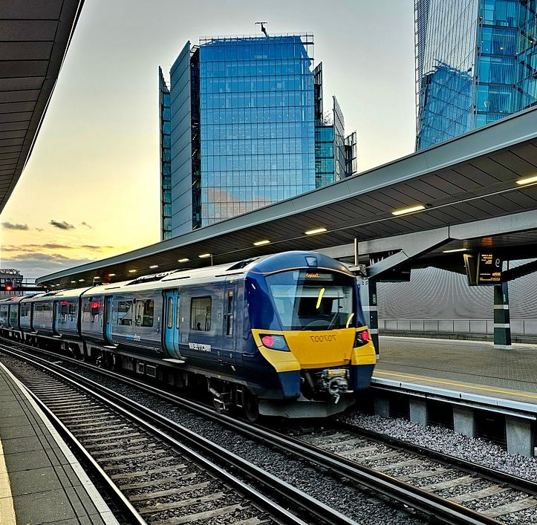
Traines Analsys
Analsys of first 4 monthes in 2025

Slide 2
Introduction
Railtics are always ready

Slide 3
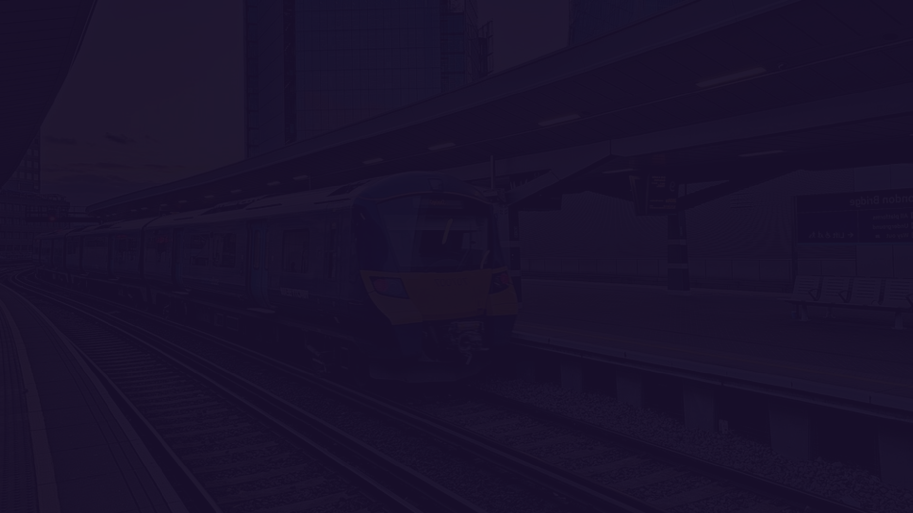
Efficient train operations are crucial for ensuring a smooth and reliable transportation system. This analysis of UK train rides aims to identify key challenges, such as delays, peak-hour congestion, and revenue loss, while also uncovering opportunities to enhance passenger experience and operational efficiency. By leveraging data- driven insights, we can implement strategies to optimize scheduling, improve service quality, and increase customer satisfaction. This presentation highlights the main goals and actionable recommendations to make train travel more efficient, reliable, and passenger-friendly.
Railtics are always ready

Slide 4
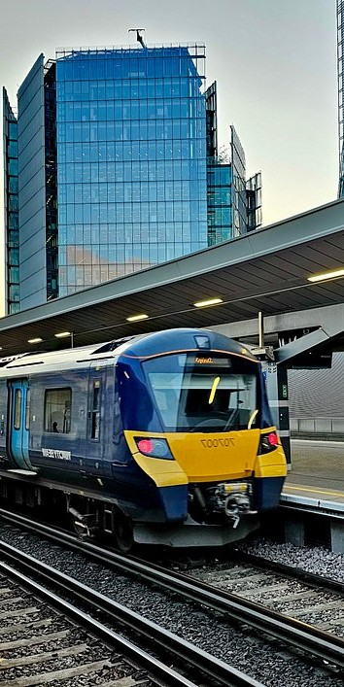
Goals to Hit
Improve train schedule accuracy and reduce delays
Effectively manage peak travel times
Enhance passenger experience and increase revenue
Enhance customer experience and efficiently handle refund requests
Improve performance at high-delay stations
Achieve higher operational efficiency through data analysis

Slide 5
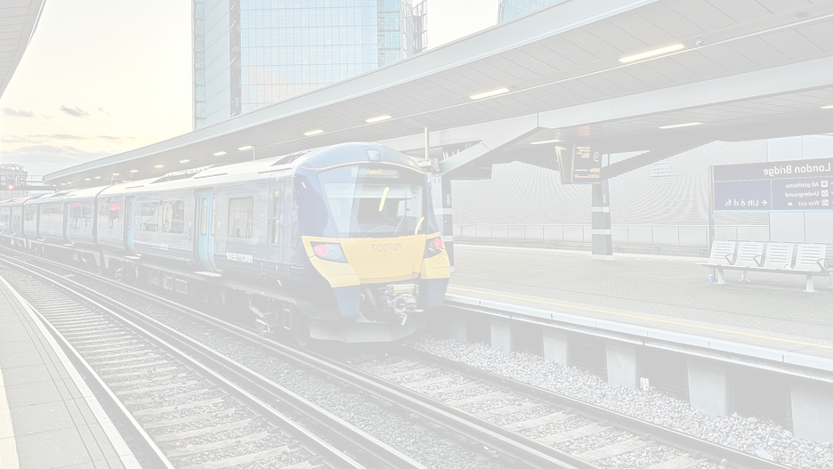

Steps
01
02
03
04
05
06
Exploratory Data Analysis (EDA)
Operational Performance Assessment
Revenue & Passenger Behavior Analysis
Identifying Key Challenges
Developing Strategic Recommendations
Implementation & Monitoring
We are here!

Slide 6
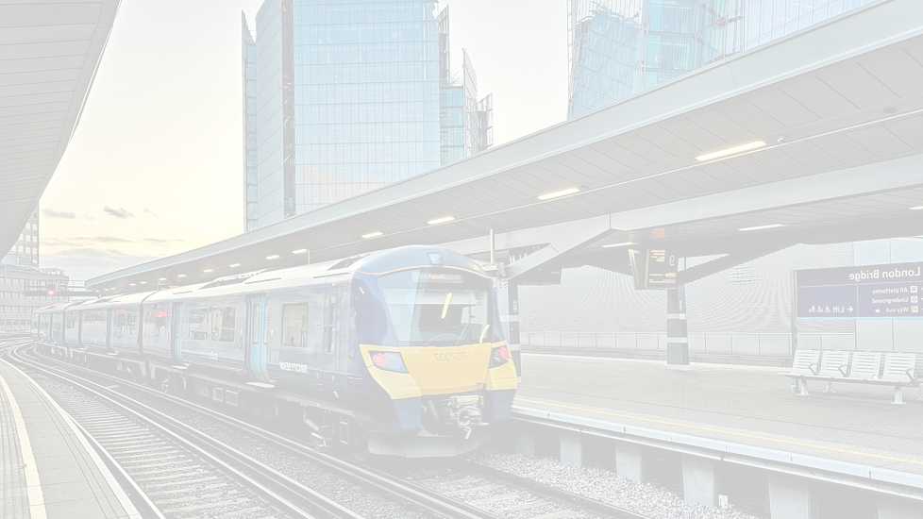
Content
01
About Data
02
Data Analysis & Insights
03
Recommendations

Slide 7
About Data
Railtics are always ready

Slide 8
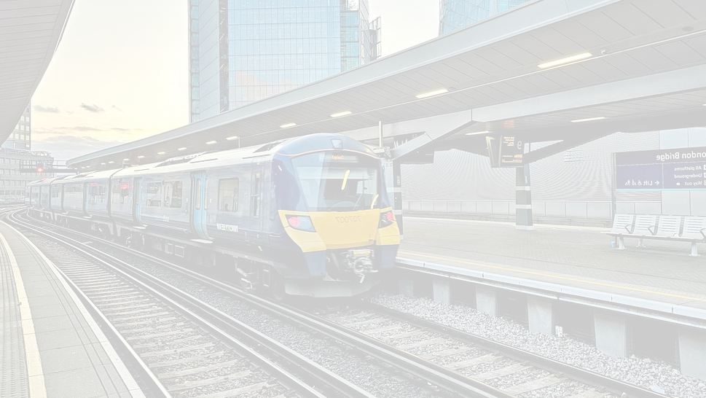
About the Data – Summary
The dataset contains detailed train ticket transactions, including:
Travel Duration & Routes – Covers various train journeys
with duration and ticket volume.
Ticket Types – Includes Anytime, Off-Peak, and Advance tickets.
Payment Methods – Tracks usage of Debit Card, Credit
Card, and Contactless payments.
Railcards – Identifies discounts for seniors, disabled passengers, and adults.
Time Categories – Analyzes ticket demand across
different times of the day.
Refund Requests – Records refund patterns based on journey status, delays, and price.
Railtics are always ready

Slide 9
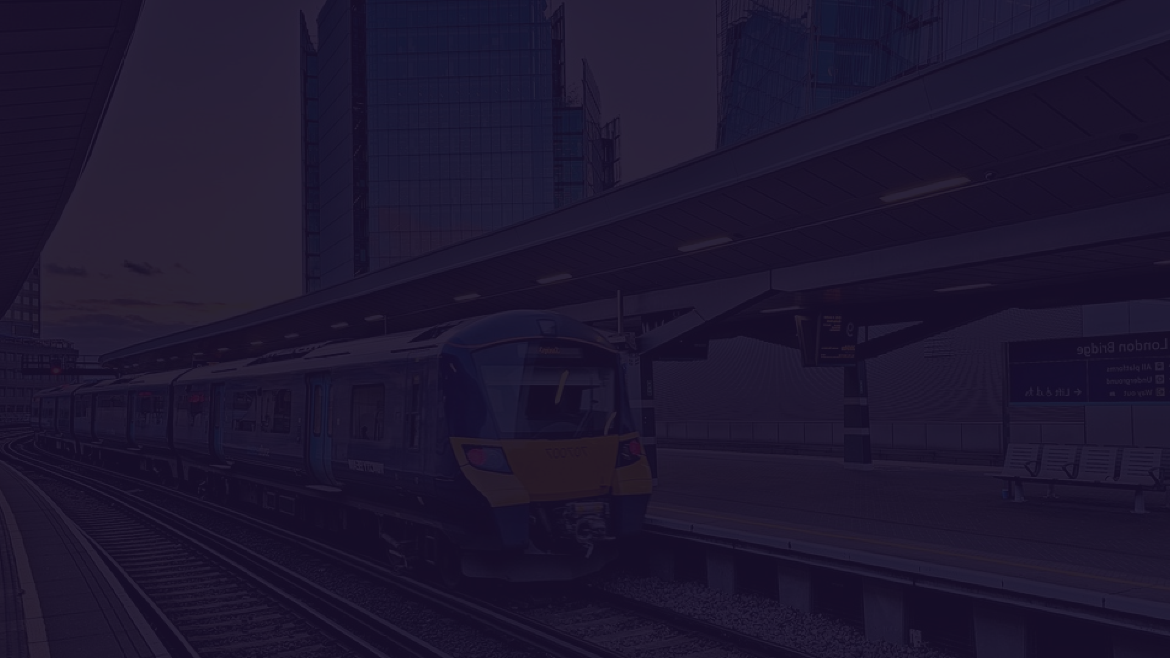
Data Analysis & Insights
Railtics are always ready

Slide 10
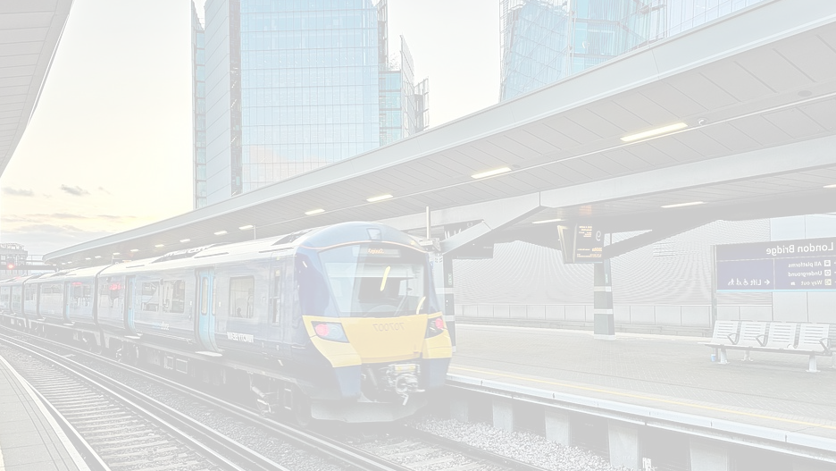
Data Analysis & Insights Dashboards
01
Overview Analysis Dashboard
02
Operational Performance Dashboard
03
Customer Behavior Dashboard
04
Customer Satisfaction & Refunds Dashboard

Slide 11
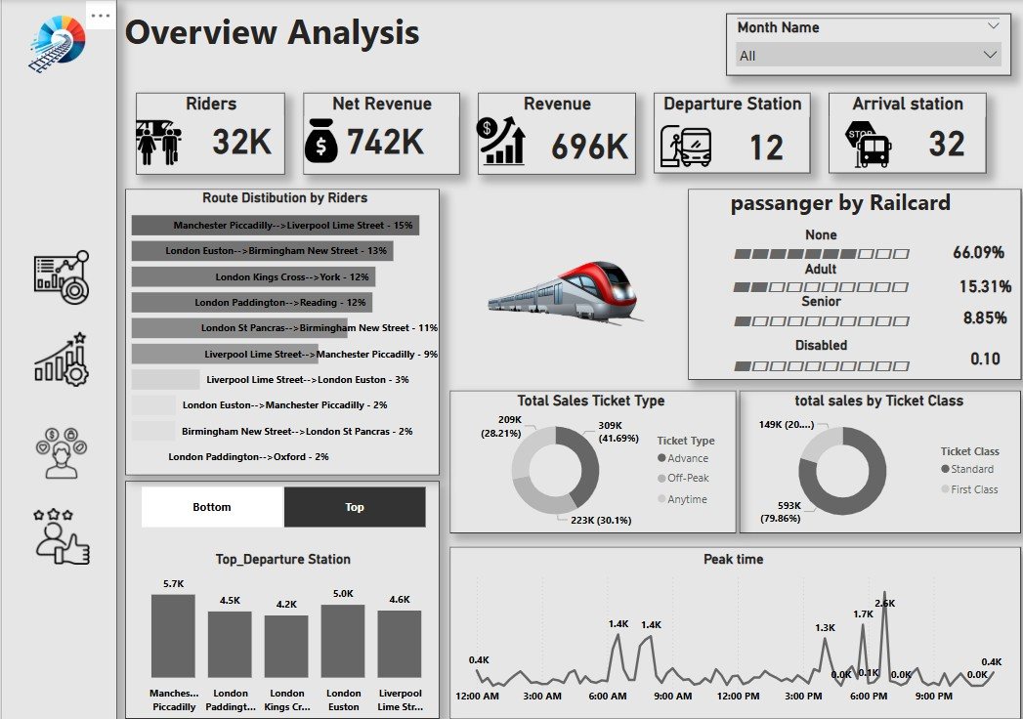
OVERVIEW ANALYSIS DASHBOARD
Riders ↔ Net Revenue & Revenue
Departure Station ↔ Arrival Station
Route Distribution by Riders ↔ Top Departure Station
Passengers by Railcard ↔ Total Sales Ticket Type
Total Sales Ticket Type ↔ Total Sales by Ticket Class
Peak Time ↔ Riders & Revenue
Top Departure Station ↔ Route Distribution by Riders

Slide 12
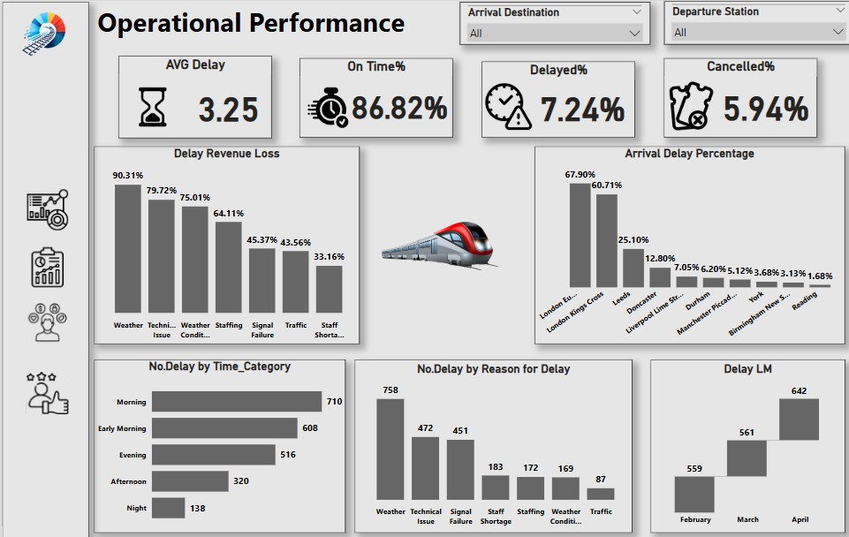
OPERATIONAL PERFORMANCE DASHBOARD
AVG Delay ↔ Delayed% & Cancelled%
Delay Revenue Loss ↔ No. Delay by Reason for Delay
Arrival Delay Percentage ↔ Departure Station & Arrival Destination
No. Delay by Time_Category ↔ Delay LM (Monthly Delays)
No. Delay by Reason for Delay ↔ Arrival Delay Percentage
Delay LM ↔ Delayed%

Slide 13
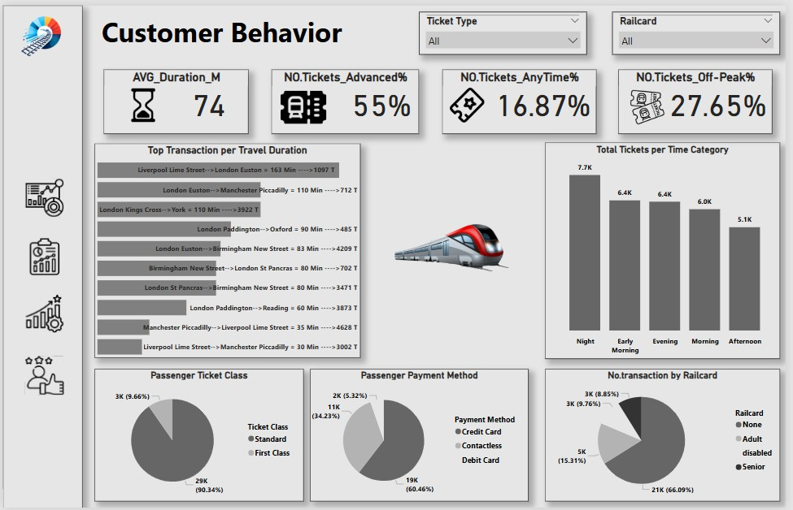
CUSTOMER BEHAVIOR DASHBOARD
AVG_Duration_M ↔ Top Transaction per Travel Duration
NO.Tickets_Advanced% ↔ NO.Tickets_AnyTime% & NO.Tickets_Off-Peak%
Total Tickets per Time Category ↔ Passenger Ticket Class
Total Tickets per Time Category ↔ Passenger Payment Method
Passenger Ticket Class ↔ Passenger Payment Method
No. transaction by Railcard ↔ Ticket Type & Passenger Class

Slide 14
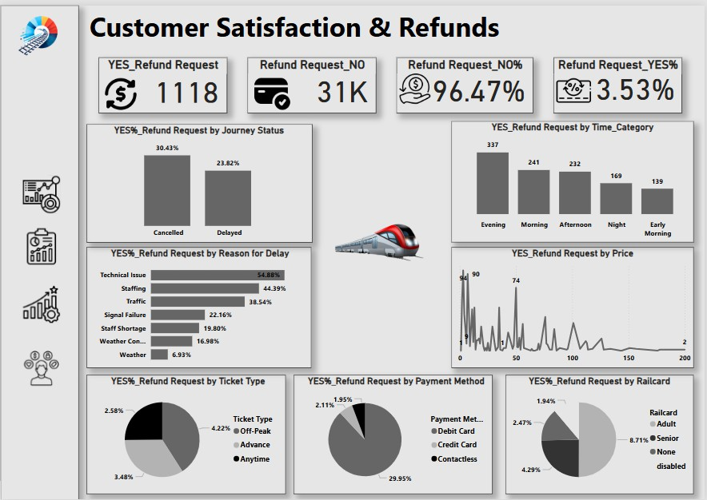
CUSTOMER SATISFACTION & REFUNDS DASHBOARD
Refund Request YES% (3.53%) ↔ Refund Request NO% (96.47%)
YES_Refund Request by Journey Status ↔ YES%_Refund Request by Reason for Delay
YES_Refund Request by Time Category ↔ YES%_Refund Request by Ticket Type
YES_Refund Request by Price ↔ YES_Refund Request by Payment Method
YES_Refund Request by Railcard ↔ Refund Request YES%

Slide 15
Recommendation
Railtics are always ready

Slide 16
Recommendations
Improve Data Accuracy – Ensure precise train schedule data for better analysis and reduced delays.
2. Optimize Resource Allocation – Assign trains based on peak demand to ease congestion.
1.
Enhance Technology Integration – Use AI to predict delays and improve scheduling.
Improve Passenger Experience – Develop digital booking systems for seamless travel.
Reduce Delays – Implement proactive maintenance
to prevent disruptions.
Expand Infrastructure – Explore new routes and upgrades to meet growing demand.
Railtics are always ready

Slide 17
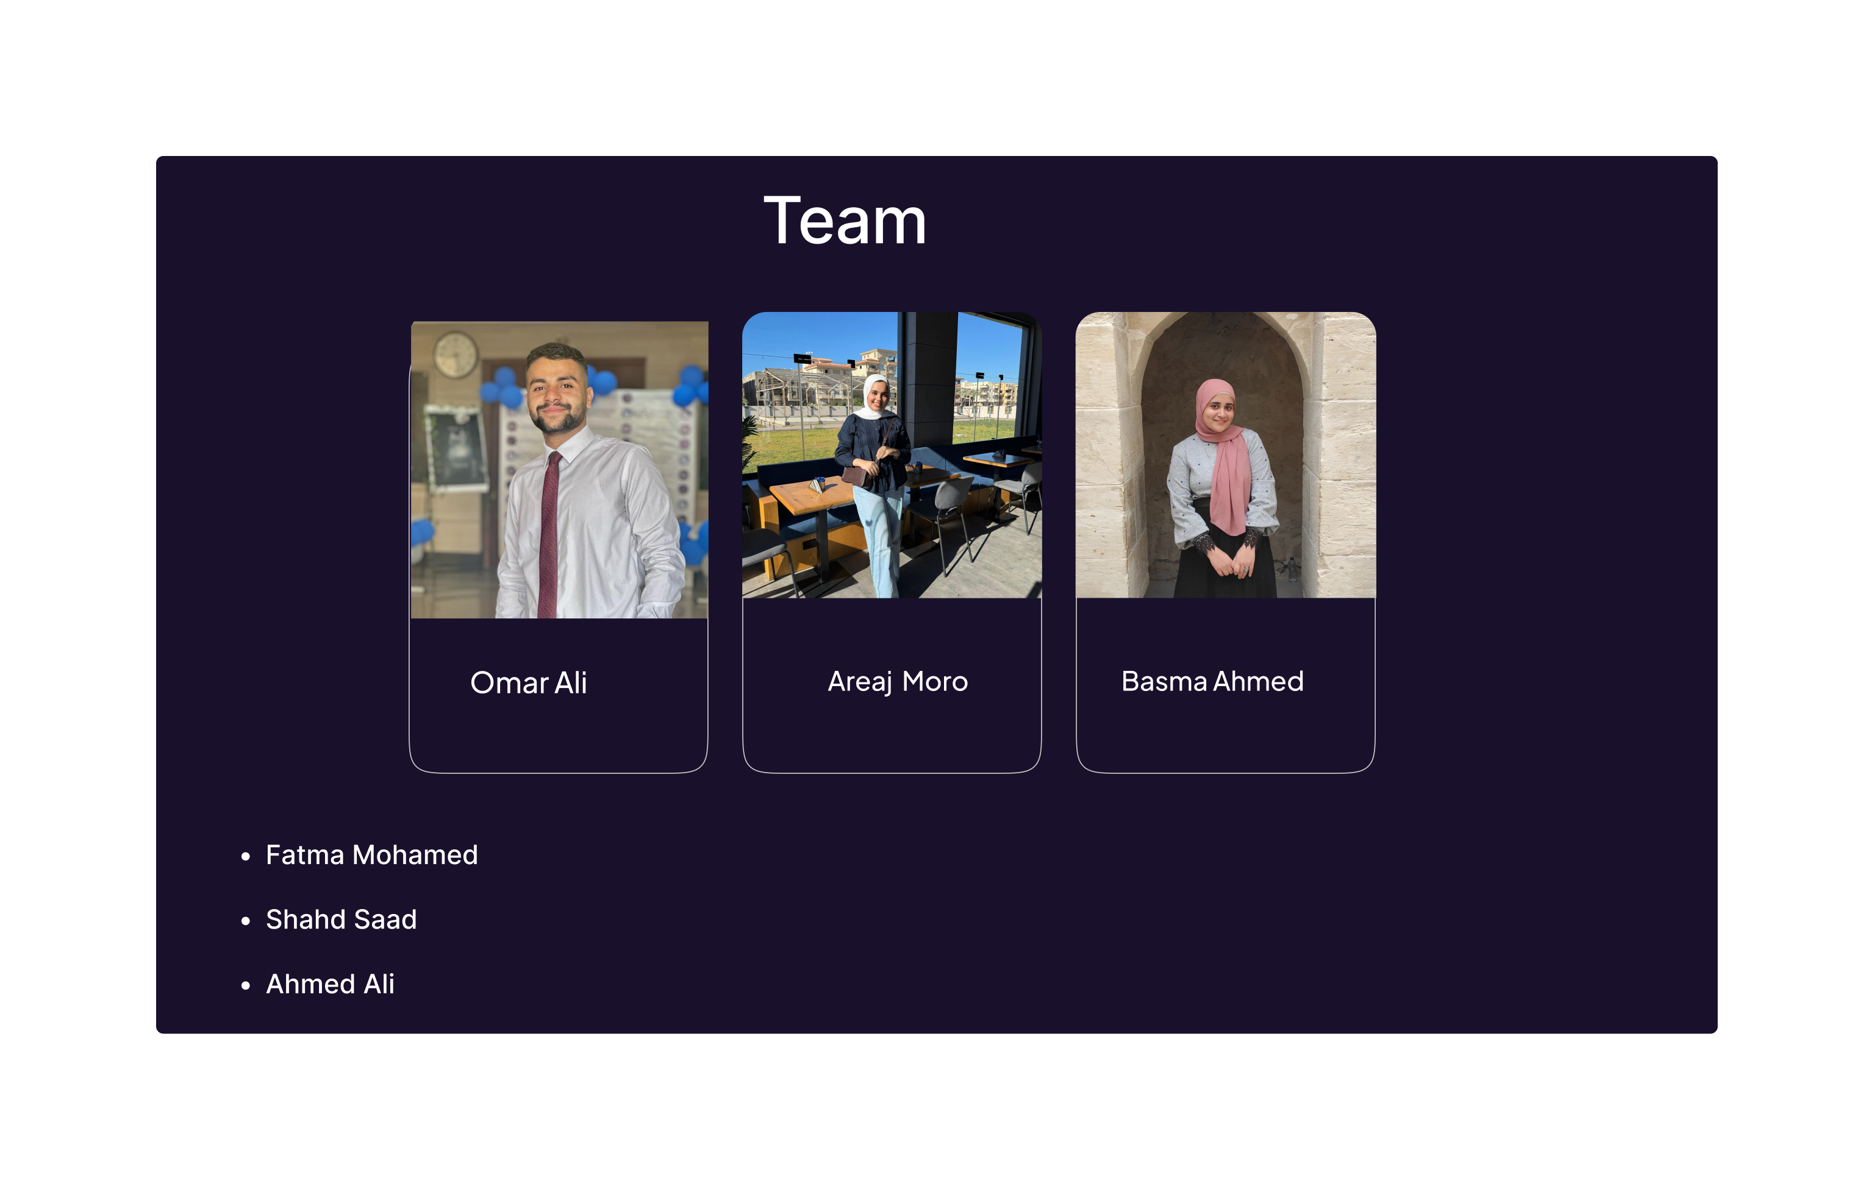

Slide 18
THANKS FOR LISTINING

